Slide 1




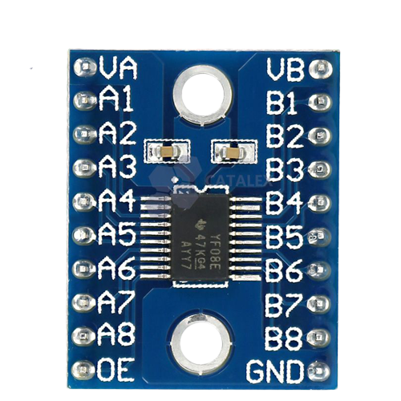

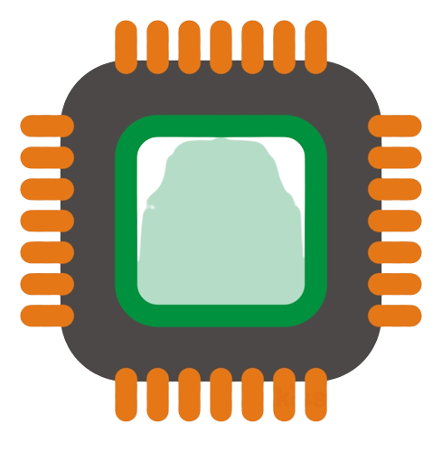
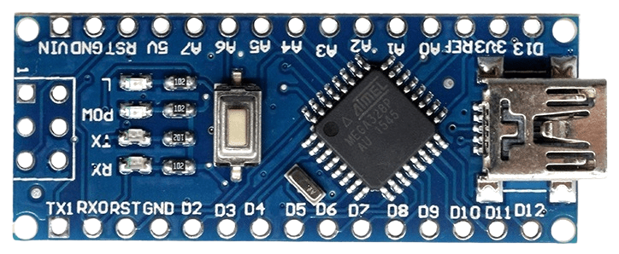
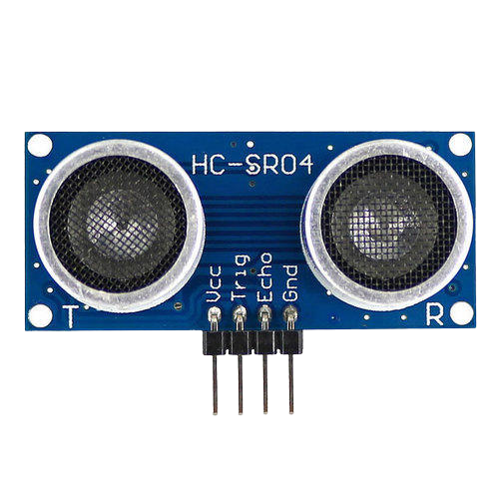
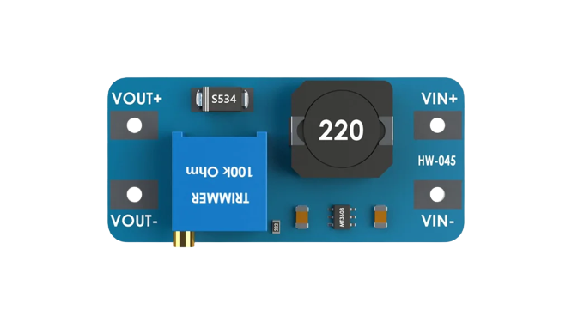

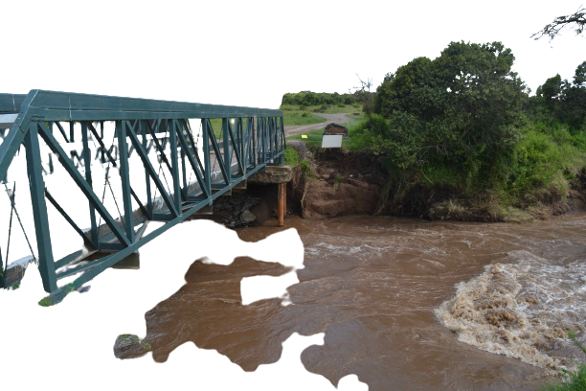
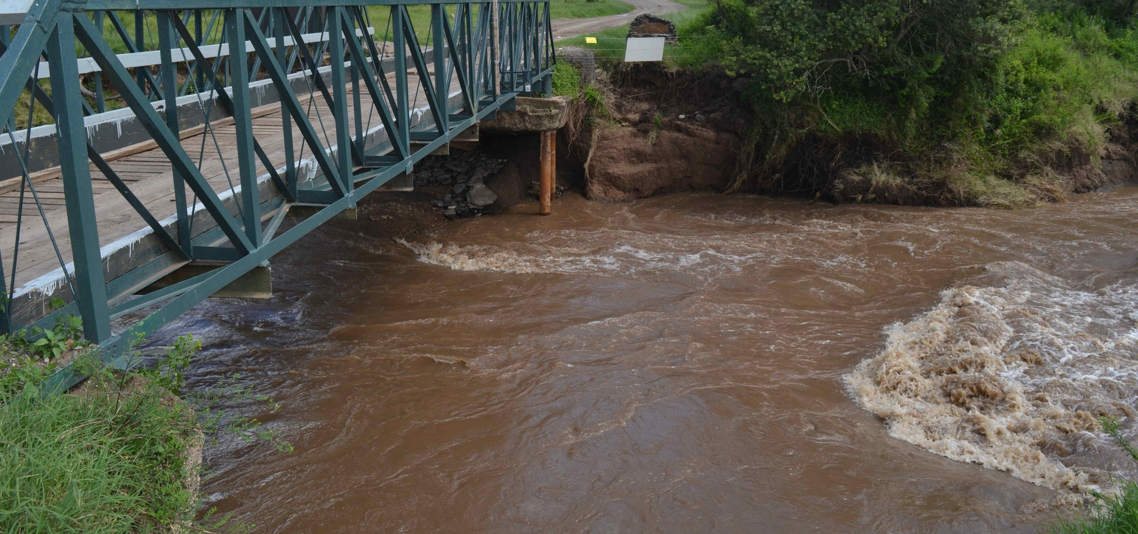


Kenet Integration
Water Level Sensor Node
MQTT Protocol
Kenet InfluxDB Machine
TXS0108E
Battery
RFM95 Transceiver
Power Regulation modules
Influx Database
Arduino NANO
HC-SR04
MT3608
Uplink
River
LoRaWAN Gateway
Anomaly Detection
Dashboard

